Slide 1
GSEG GA Meeting
11/19/2024

Slide 2
Agenda
Food 10 min
Roll call - 5 min
Updates from the Executive Board - 15 min
Departmental Updates - 5 min
GSEG Elections - 15 min
Aim to end by 6:30 pm

Slide 3
President Updates
Do you want to get involved more with GSEG or GAPSA planning?
Gala now March 22nd, 2025 at the Fillmore
We are looking to train next year’s executive board
Discussions w admin & GAPSA have included:
What to do when a student fails qualifying exam
Steps to navigate advisor running out of money
Engineering Entrepreneurship class EAS5490
Grad Student support - what do you need support?
Transportation - radius the penn bus reaches and timing (reliability)
Course selection period and naming of courses
Misleading to employers…elementary names for advanced courses
Accessibility for students outside department but in your field → doesn’t get priority to get into classes outside the department; more cross registration opportunities; thinking about
Hard time w some electives for CBE, MSE students

Slide 4
Vice President Updates
Anyone not have a chance to meet with Owen?
Join the GAPSA slack

Slide 5
Finance Updates
REF | Line Item | RS Count | RS % | Penalty | Redistribution | Appropriation | Utilization | Balance
 | TOTAL | 2749 | 100.00% | 0 | $ - | $ 25,000.00 | $ 8,414.57 | $ 16,585.44
2.1.1 | Bioengineering | 454 | 16.52% | 0 | $ - | $ 4,587.27 | $4,118.72 | $ 468.55
2.2.1 | Chemical and Biomolecular Engineering | 131 | 4.77% | 0 | $ - | $ 1,869.65 | $309.15 | $ 1,560.50
2.3.1 | Computer and Information Science (PhD) | 208 | 7.57% | 0 | $ - | $ 1,481.70 | $0.00 | $ 1,481.70
2.3.2 | Computer and Information Science (MSE (CIS, CGGT)) | 279 | 10.15% | 0 | $ - | $ 2,128.61 | $0.00 | $ 2,128.61
2.3.3 | Computer and Information Science (MCIT) | 195 | 7.09% | 0 | $ - | $ 1,402.48 | $0.00 | $ 1,402.48
2.3.4 | Computer and Information Science (DATS) | 203 | 7.38% | 0 | $ - | $ 1,451.23 | $1,338.00 | $ 113.23
2.4.1 | Electrical and Systems Engineering (PhD) | 131 | 4.77% | 0 | $ - | $ 1,155.37 | $879.98 | $ 275.39
2.4.2 | Electrical and Systems Engineering (MSE (EE, SE)) | 433 | 15.75% | 0 | $ - | $ 3,352.69 | $1,480.00 | $ 1,872.69
2.5.1 | Material Science and Engineering | 132 | 4.80% | 0 | $ - | $ 1,875.75 | $128.21 | $ 1,747.54
2.6.1 | Mechanical Engineering and Applied Mechanics | 225 | 8.18% | 0 | $ - | $ 2,085.28 | $0.00 | $ 2,085.28
2.6.2 | Integrated Product Design | 57 | 2.07% | 0 | $ - | $ 704.46 | $0.00 | $ 704.46
2.7.1 | Biotechnology | 106 | 3.86% | 0 | $ - | $ 913.75 | $160.50 | $ 753.25
2.7.2 | Nanotechnology | 15 | 0.55% | 0 | $ - | $ 359.26 | $0.00 | $ 359.26
2.7.3 | Robotics | 140 | 5.09% | 0 | $ - | $ 1,120.92 | $0.00 | $ 1,120.92
2.7.4 | SCMP | 40 | 1.46% | 0 | $ - | $ 511.59 | $0.00 | $ 511.59

Slide 6
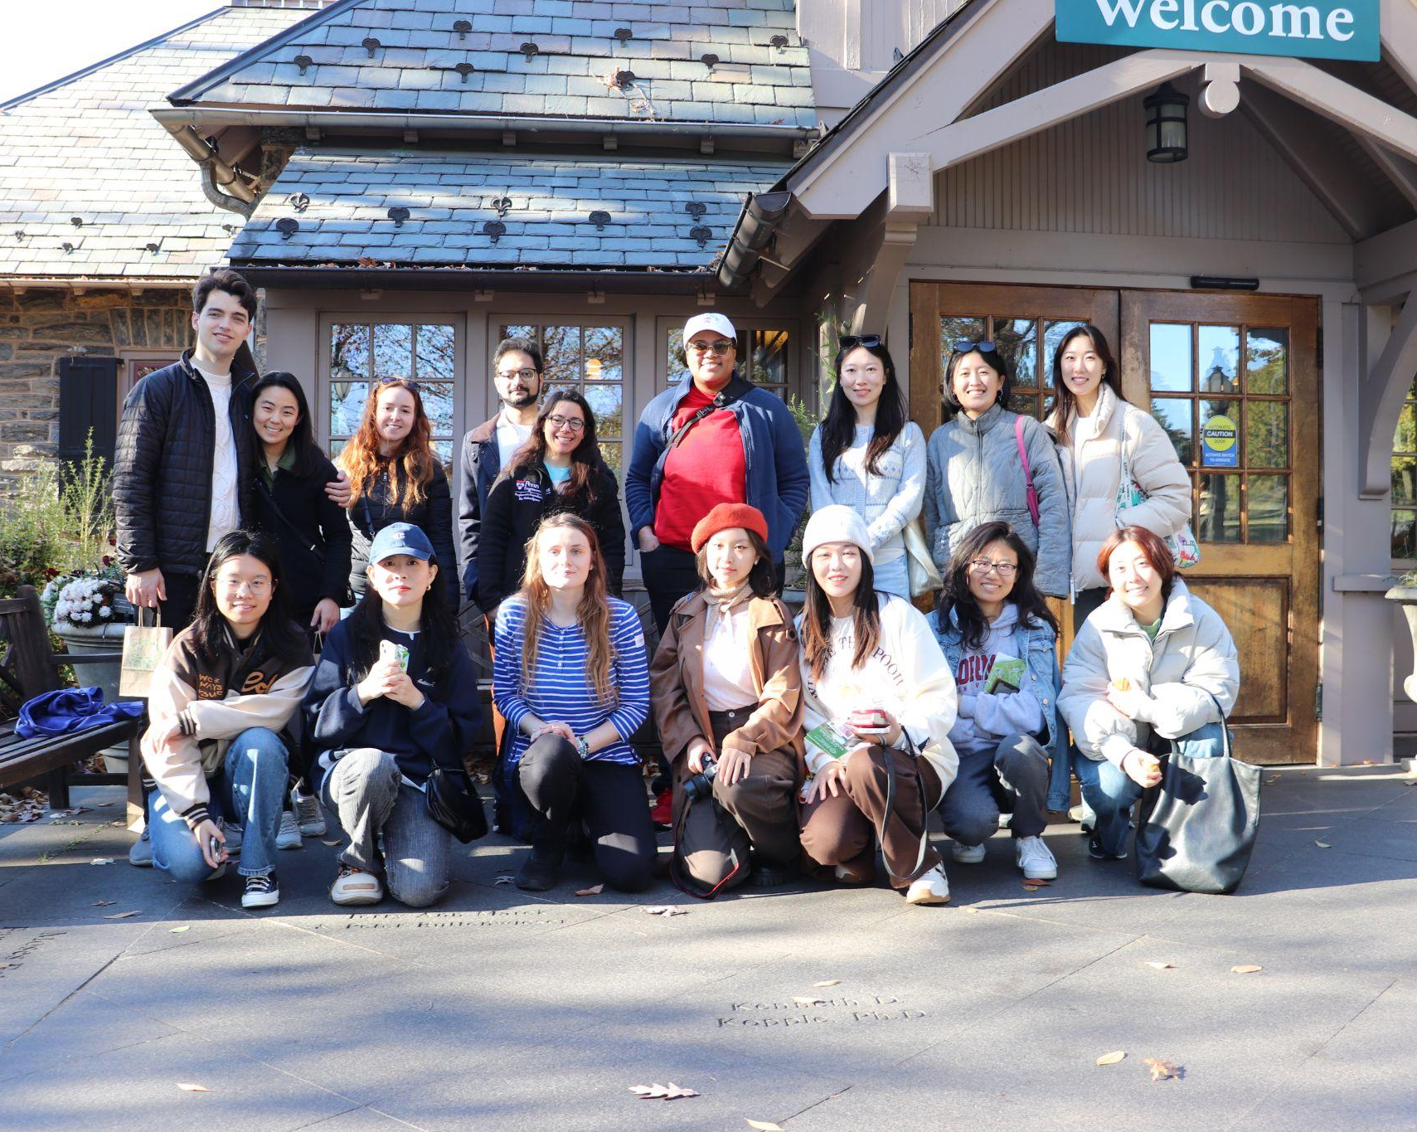
Programming Updates - November
Free donuts & Morris Arboretum
Thanksgiving Happy Hour
Thurs. at 5:30 PM
Collaboration w/ Wharton
Opera Night
Tues, 11/26 at 7:30 PM
Organized by Tricia Lobo
Links in newsletter!

Slide 7
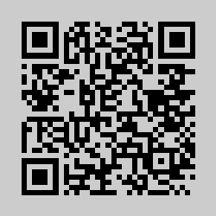
Programming Updates - December
Pottery Workshop
Black Hand Clay
December 9th
Food Holiday
December 20/23
Vote: https://tinyurl.com/mjb9fan5

Slide 8
Programming Updates - Coming Soon!
January/February
Welcome Back Happy Hour
Food Holiday
76ers
Flyers, 2/25

Slide 9
Logistics Updates
N/A

Slide 10
Departmental Representatives - updates for the GA?
SCMP: BE collab hh- 100%
ESE (M): ice skating event in early december; 2 study breaks
CHEGA: monthly happy hour; poker night with profs; 2 big events - brewery tour at dock street; synergy w MATGO at Barcade
MEAM (PhD): study session; ice skating and trivia night for Jan
MATGO: Pumpkin painting w pizza and drinks; ice skating; chega collab
BIOT: Collab w GABE/MAB for thanksgiving; end of semester in december for finals
MEGA and CIS will collab → happy hour go all out
GABE: has high utilization
IPD: not here
ROBO: Minigolf or karaoke; free coffee and donuts;

Slide 11
GAPSA Rep updates?
Finance chair is needed
Reporting - money flow; data from admin
Funding management - distribution
Thanksgiving Global event on Tuesday Nov 26 - $12.5 for grad students; $37.5 for guests - lots of food

Slide 12
Masters GAPSA Rep Elections

Slide 13
Nominations
Rishvandh Kalaivani Prabu

Slide 14
Any further questions?
Instagram account: @gseg_upenn
Email: gseg@seas.upenn.edu

Slide 15
Links & Logistics
Advertise in the GSEG Newsletter
Submit an event idea
Website
Doc

