Slide 1
GSEG GA Meeting
12/10/2024

Slide 2
Agenda
Food 10 min
Roll call - 5 min
Updates from the Executive Board - 15 min
Departmental Updates - 5 min
Aim to end by 6:15 pm

Slide 3
President Updates
GAC meeting this Friday - what concerns would you like to raise?
Groupchat of GAPSA reps - are all GAPSA reps in it?

Slide 4
President Updates
From Last time:
What to do when a student fails qualifying exam
Steps to navigate advisor running out of money
Engineering Entrepreneurship class EAS5490
Grad Student support - what do you need support?
Transportation - radius the penn bus reaches and timing (reliability)
On demand was moved to 7:30pm
Buses only cover so much area (North bus is insufficient for student needs)
Course selection period and naming of courses
Misleading to employers…elementary names for advanced courses
Accessibility for students outside department but in your field → doesn’t get priority to get into classes outside the department; more cross registration opportunities; thinking about
Hard time w some electives for CBE, MSE students

Slide 5
Vice President Updates
Anyone not have a chance to meet with Owen?
Join the GAPSA slack

Slide 6
Finance Updates
REF | Sub-item | Appropriation | Utilization | Balance | * Accounting Error
 | TOTAL | $ 25,000.00 | $ 10,073.67 | $ 14,926.34 | 40.29%
2.1.1 | BE | $ 4,587.27 | $ 3,818.72 | $ 768.55 | 83.25%
2.2.1 | CBE | $ 1,869.65 | $ 419.64 | $ 1,450.01 | 22.44%
2.3.1 | CIS (PhD) | $ 1,481.70 | $ - | $ 1,481.70 | 0.00%
2.3.2 | CIS (M) | $ 2,128.61 | $ - | $ 2,128.61 | 0.00%
2.3.3 | CIS (MCIT) | $ 1,402.48 | $ - | $ 1,402.48 | 0.00%
2.3.4 | CIS (DATS) | $ 1,451.23 | $ 1,338.00 | $ 113.23 | 92.20%
2.4.1 | ESE (PhD) | $ 1,155.37 | $ 879.98 | $ 275.39 | 76.16%
2.4.2 | ESE (M) | $ 3,352.69 | $ 1,480.00 | $ 1,872.69 | 44.14%
2.5.1 | MSE | $ 1,875.75 | $ 128.21 | $ 1,747.54 | 6.84%
2.6.1 | MEAM | $ 2,085.28 | $ 1,848.61 | $ 236.67 | 88.65%
2.6.2 | IPD | $ 704.46 | $ - | $ 704.46 | 0.00%
2.7.1 | BIOT | $ 913.75 | $ 160.50 | $ 753.25 | 17.57%
2.7.2 | NANO | $ 359.26 | $ - | $ 359.26 | 0.00%
2.7.3 | ROBO | $ 1,120.92 | $ - | $ 1,120.92 | 0.00%
2.7.4 | SCMP | $ 511.59 | $ - | $ 511.59 | 0.00%

Slide 7
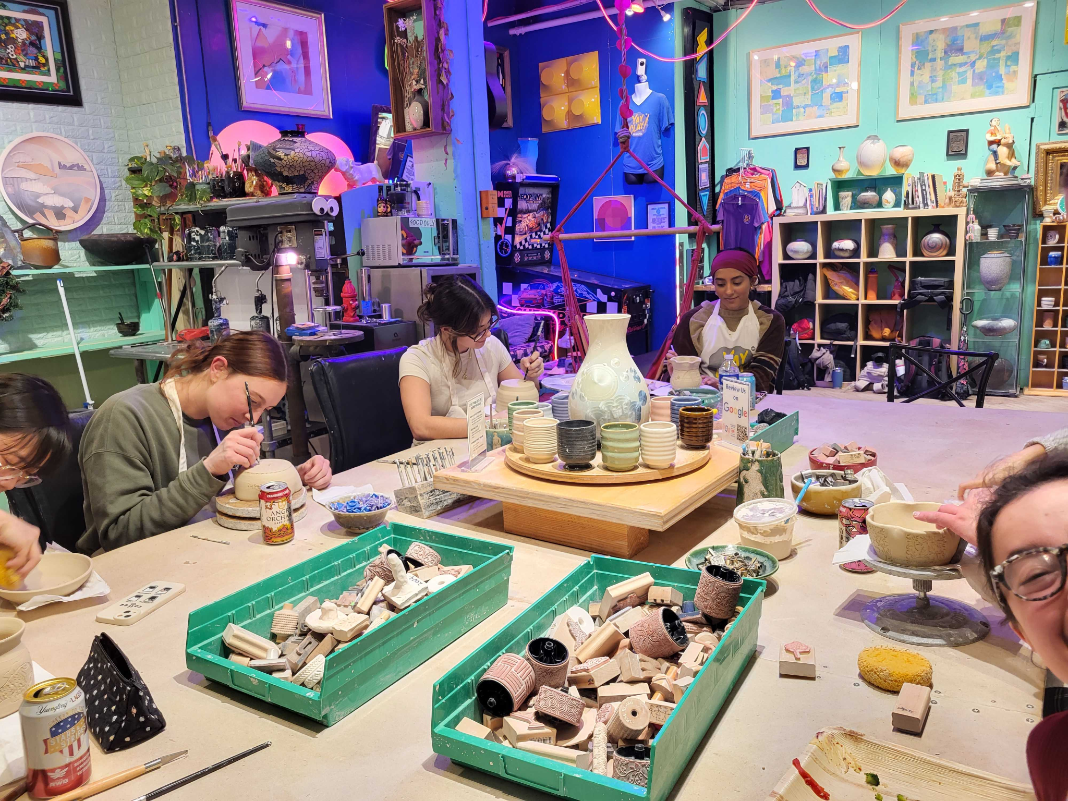
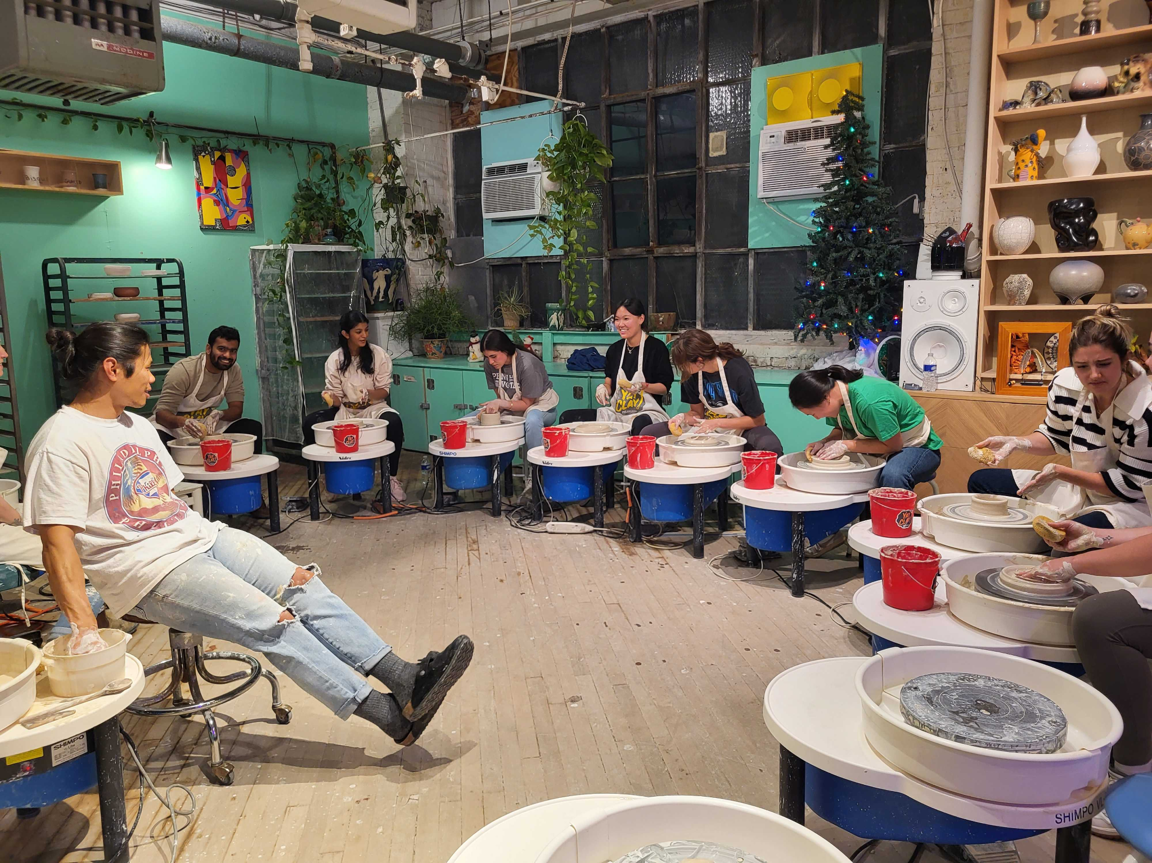
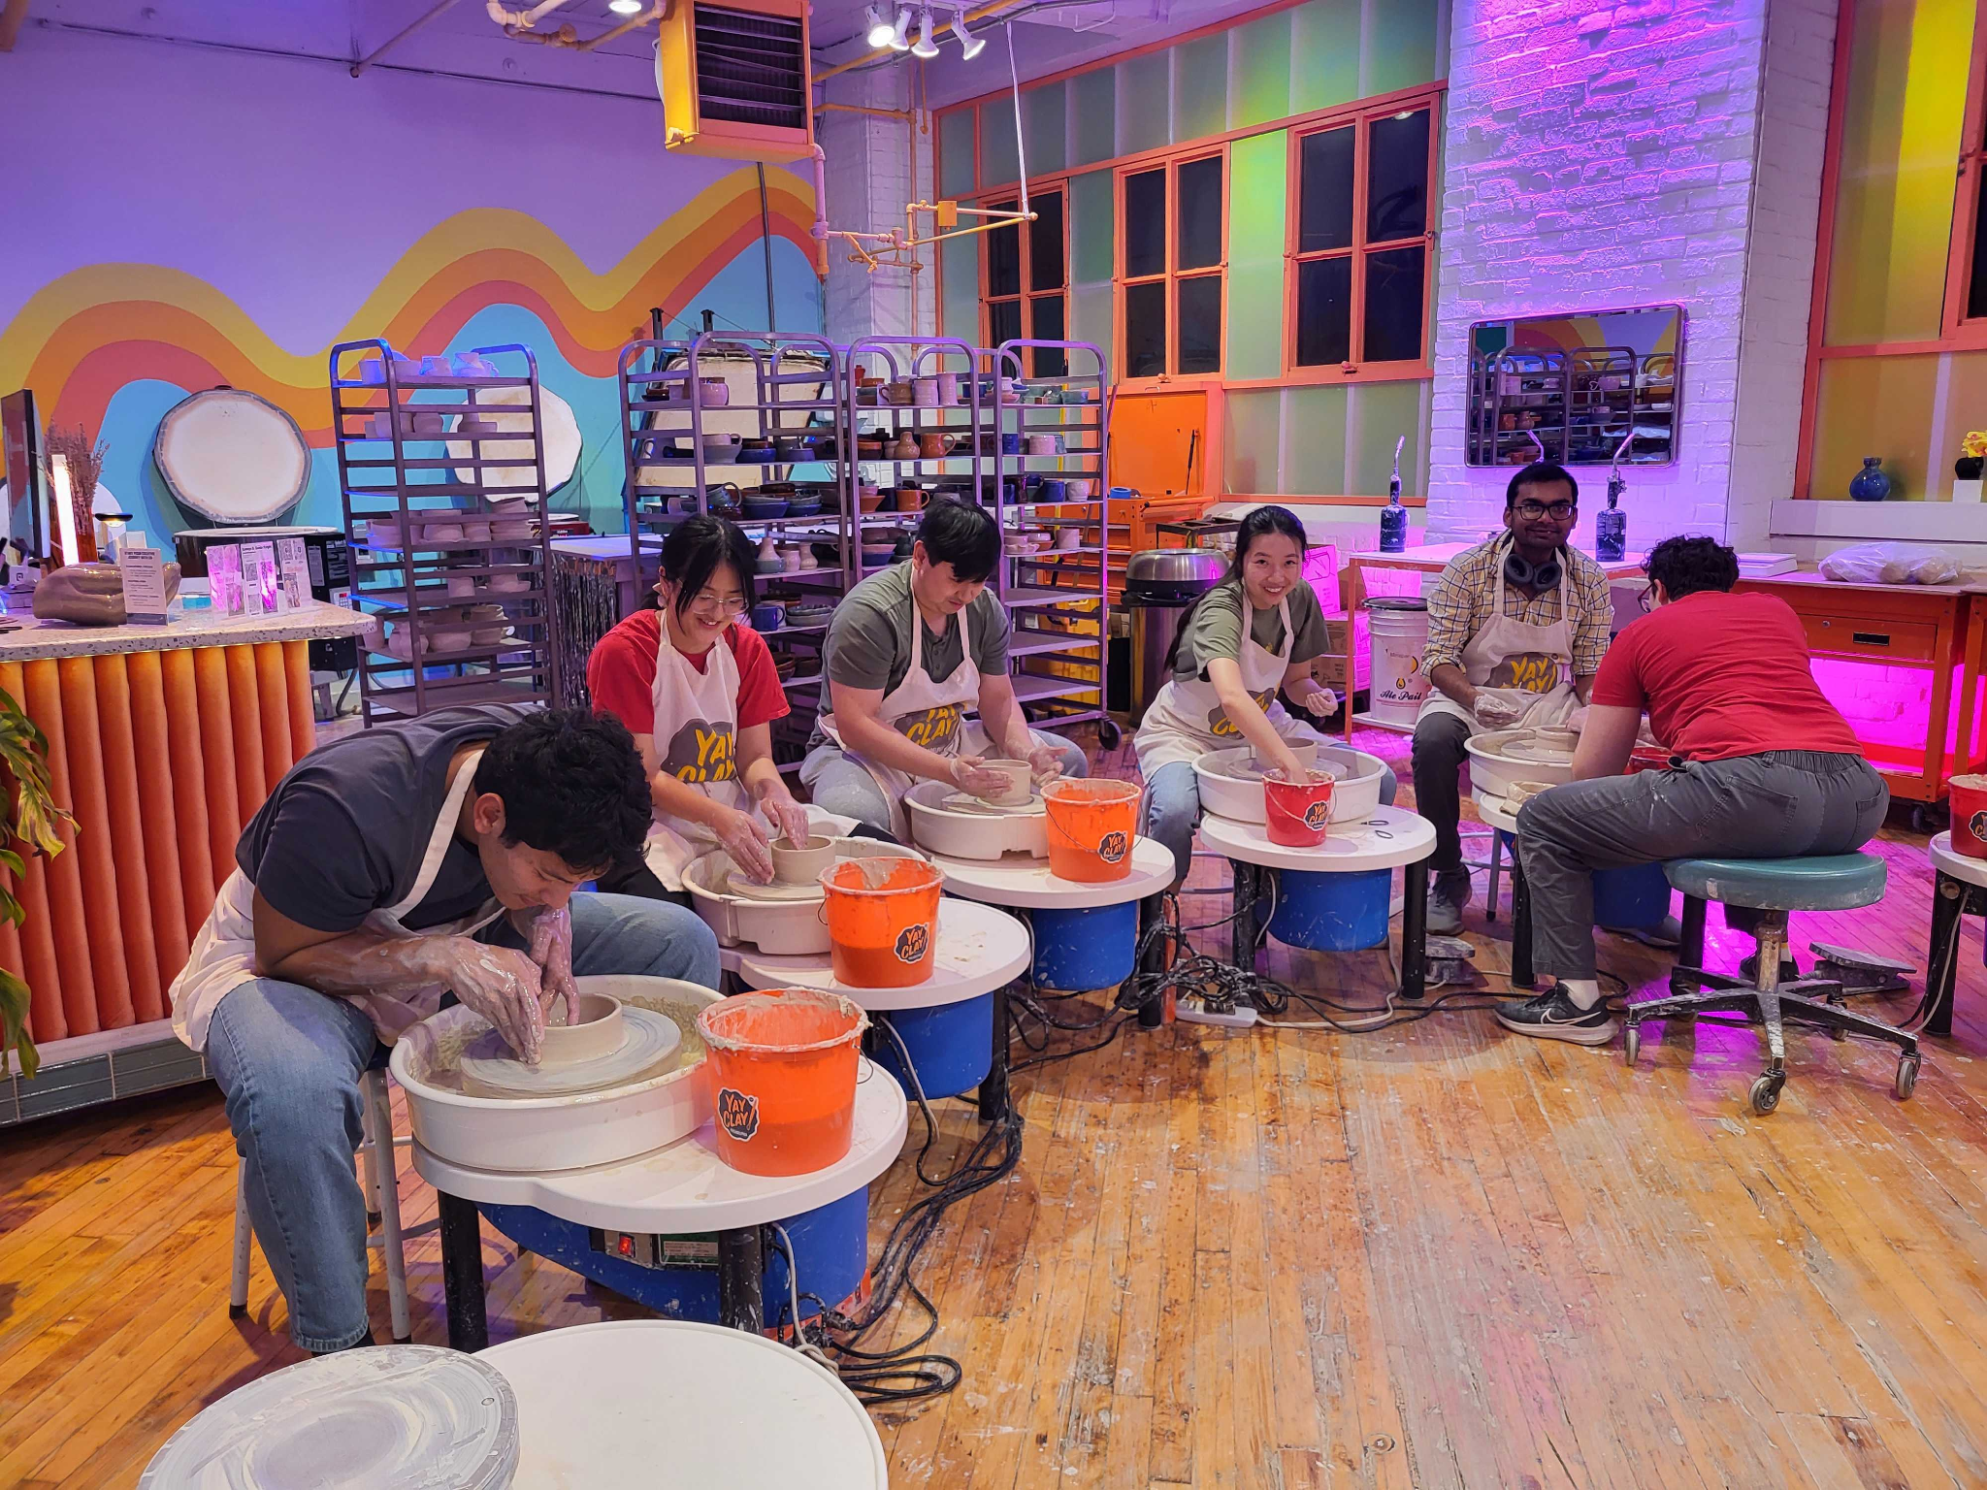
Previously on Programming…
Pottery Workshop at Yay Clay!

Slide 8
Next on Programming
December 20th: Free Dumplings!*
January 9th/16th: Welcome Back Happy Hour!*
Quick poll
January 22nd: Food Holiday*
January 29th: 76ers (Basketball)!
February 25th: Flyers (Hockey)!*
*These dates are tentative

Slide 9
Logistics Updates
N/A

Slide 10
Departmental Representatives - updates for the GA?

Slide 11
GAPSA Rep updates?

Slide 12
Masters GAPSA Rep Elections

Slide 13
Nominations

Slide 14
Any further questions?
Instagram account: @gseg_upenn
Email: gseg@seas.upenn.edu

Slide 15
Links & Logistics
Advertise in the GSEG Newsletter
Submit an event idea
Website
Doc

