Slide 1
GSEG GA Meeting
2/25/2025

Slide 2
Agenda
Food 10 min
Roll call - 5 min
Updates from the Executive Board - 15 min
Departmental Updates - 5 min

Slide 3
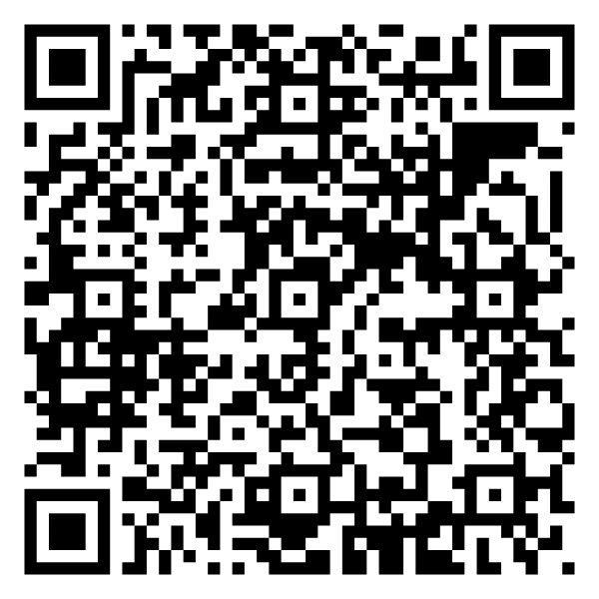
Roll Call: Non-voting, voting, and GAPSA reps sign in here!

Slide 4
President Updates
University Council Meeting - if you have a concern, send it in so you can voice it
stulife@seas.upenn.edu
Resources and Opportunities
https://mail.google.com/mail/u/0/#inbox/FMfcgzQZTMRbLxlMhdCtQZqJNMHSNCxC
ICare: https://wellness.upenn.edu/wellbeing-initiatives/i-care
Listening Session for International Students:
https://www.eventbrite.com/e/listening-session-with-international-student-leaders-tickets-1255810676539
Run for GAPSA exec board

Slide 5
Vice President Updates

Slide 6
Finance Updates

Slide 7
 |  | Appropriation
 | TOTAL | $ 123,052.40
Tied Fraction | SUBTOTAL | $ 38,052.40
1.1 | Inter-school Partnership Fund | $ 18,052.40
1.2 | Contingency Fund | $ 10,000.00
1.3 | Synergy Fund | $ 10,000.00
Fall Spend
Departmental Allocation | SUBTOTAL | $ 30,000.00
2.1 | BE | $ 5,504.73
2.2 | CBE | $ 2,243.58
2.3 | CIS | $ 5,428.86
2.4 | ESE | $ 3,069.42
2.5 | MSE | $ 2,250.90
2.6 | MEAM | $ 4,023.23
2.7 | CDP | $ 4,892.46
GSEG Base | SUBTOTAL | $55,000.00
3.1 | Operations & Advocacy | $ 5,000.00
3.2 | Programming | $ 40,000.00
3.3 | Funding | $ 10,000.00
Reserves | For Next Semester | $ 57,471.60
 | TOTAL | $ 30,000.00
2.1.1 | BE | $ 5,504.73
2.2.1 | CBE | $ 2,243.58
2.3.1 | CIS (PhD) | $ 1,778.03
2.3.2 | CIS (M) | $ 2,554.33
2.3.3 | CIS (MCIT) | $ 1,682.98
2.3.4 | CIS (DATS) | $ 1,741.47
2.4.1 | ESE (PhD) | $ 1,386.44
2.4.2 | ESE (M) | $ 4,023.23
2.5.1 | MSE | $ 2,250.90
2.6.1 | MEAM | $ 2,502.34
2.6.2 | IPD | $ 845.35
2.7.1 | BIOT | $ 1,096.50
2.7.2 | NANO | $ 431.11
2.7.3 | ROBO | $ 1,345.11
2.7.4 | SCMP | $ 613.91

Slide 8
Previously on Programming
January Happy Hour (Libertee Grounds)
February Cookie Giveaway
GSEG x Wharton February Happy Hour (Armory)
Brahms’s Symphony No. 4
Tonight: Flyers vs. Penguins
Notes:
(all of our programming since our last GA meeting)

Slide 9
Programming: Coming Up
March 3rd: Free Dumplings!
March HH*
GAPSA Gala is March 22nd
Notes:
*Check if people will be around during spring break (2nd week of march) or would prefer a happy hour last week of March

Slide 10
Logistics Updates
N/A

Slide 11
Departmental Representatives - updates for the GA?
GABE: recruitment, event w ugrads, BE Active
MATGO: Midsemester lunch; trivia night
MEGA: trivia night; ice skating with SCMP
CHEGA: monthly happy hour; recruitment
CIS: weekly friday dinners
ESE: 2 happy hours; speaker lineup for colloquium series
ESE+IPD collab
IPD: chinese new year party, super bowl, march

Slide 12
GAPSA Rep updates?
March 5 - GAPSA elections
Emails
Prelim budget for 2025-2026 - changes w current budget
Spring gala for free - volunteer/sober host

Slide 13
Last Chance at Roll Call: Non-voting, voting, and GAPSA reps sign in here!

Slide 14
Any further questions?
Instagram account: @gseg_upenn
Email: gseg@seas.upenn.edu

Slide 15
Links & Logistics
Advertise in the GSEG Newsletter
Submit an event idea
Website
Doc

