Slide 1
GSEG GA Meeting
3/25/2025

Slide 2
Agenda
Food 10 min
Roll call - 5 min
Updates from the Executive Board - 15 min
Departmental Updates - 5 min

Slide 3
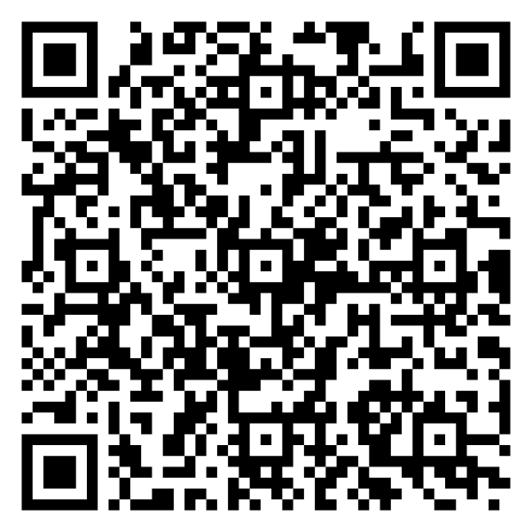
Roll Call: Non-voting, voting, and GAPSA reps sign in here!

Slide 4
President Updates
Last 5 weeks of the semester
Food giveaways
Coffee/hot chocolate, Bubble tea, soft-serve ice cream, water ice/Ritas, ice cream sandwiches,
Anyone available to help with this?
Thursdays 1-3pm
GSEG Elections next meeting!
Run for GAPSA exec board

Slide 5
Vice President Updates
Please everyone meet with Makyla to update her on your spending

Slide 6
Finance Updates

Slide 7
 |  | Appropriation
 | TOTAL | $ 123,052.40
Tied Fraction | SUBTOTAL | $ 38,052.40
1.1 | Inter-school Partnership Fund | $ 18,052.40
1.2 | Contingency Fund | $ 10,000.00
1.3 | Synergy Fund | $ 10,000.00
Fall Spend
Departmental Allocation | SUBTOTAL | $ 30,000.00
2.1 | BE | $ 5,504.73
2.2 | CBE | $ 2,243.58
2.3 | CIS | $ 5,428.86
2.4 | ESE | $ 3,069.42
2.5 | MSE | $ 2,250.90
2.6 | MEAM | $ 4,023.23
2.7 | CDP | $ 4,892.46
GSEG Base | SUBTOTAL | $55,000.00
3.1 | Operations & Advocacy | $ 5,000.00
3.2 | Programming | $ 40,000.00
3.3 | Funding | $ 10,000.00
Reserves | For Next Semester | $ 57,471.60
 | TOTAL | $ 30,000.00
2.1.1 | BE | $ 5,504.73
2.2.1 | CBE | $ 2,243.58
2.3.1 | CIS (PhD) | $ 1,778.03
2.3.2 | CIS (M) | $ 2,554.33
2.3.3 | CIS (MCIT) | $ 1,682.98
2.3.4 | CIS (DATS) | $ 1,741.47
2.4.1 | ESE (PhD) | $ 1,386.44
2.4.2 | ESE (M) | $ 4,023.23
2.5.1 | MSE | $ 2,250.90
2.6.1 | MEAM | $ 2,502.34
2.6.2 | IPD | $ 845.35
2.7.1 | BIOT | $ 1,096.50
2.7.2 | NANO | $ 431.11
2.7.3 | ROBO | $ 1,345.11
2.7.4 | SCMP | $ 613.91

Slide 8
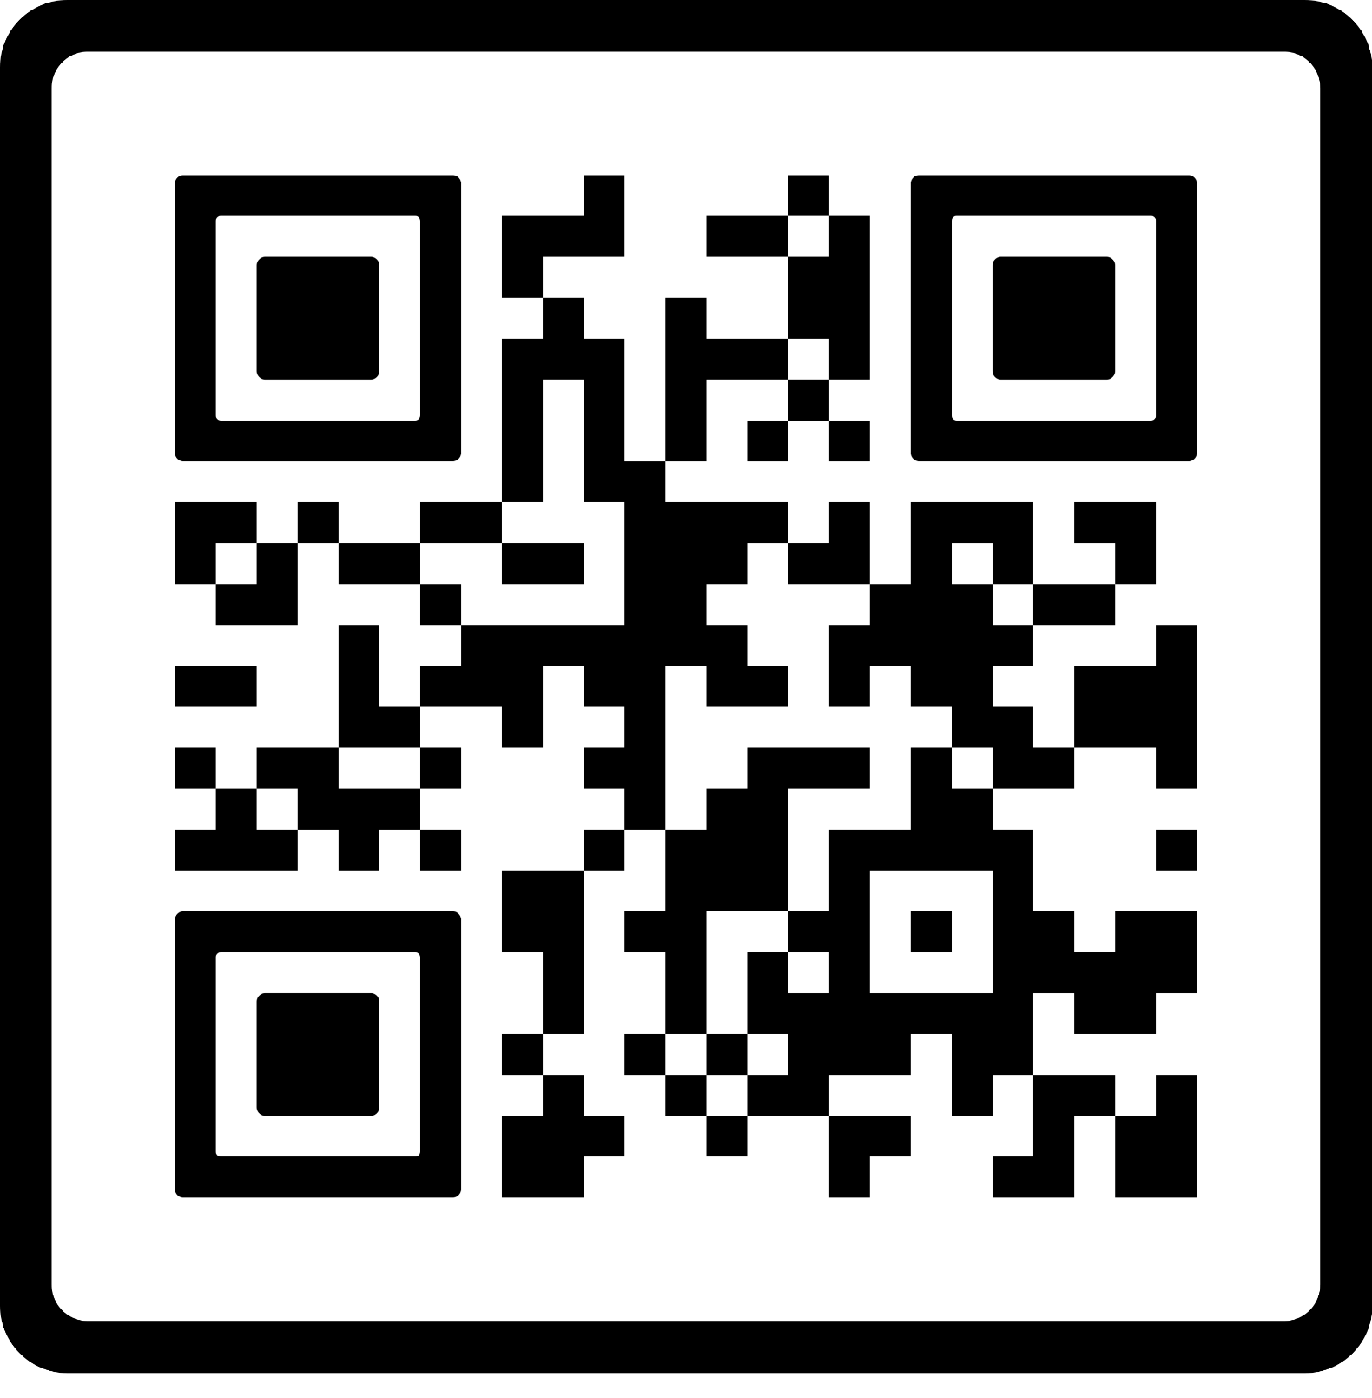
Programming
TOMORROW: March Happy Hour
April 1st: Candle Making Workshop
April 5th: Running w/ Weitzman*
April 3rd: Pub w/ Wharton
April 9th: Free Macarons
April 19th: Gala*
LINKTREE
Notes:
-Registration links on our link tree
-Details in the newsletter and our insta account @gseg_upenn!
-HH promo codes in the slack channel for reps (if you’re not in the slack, you’re missing out)

Slide 9
Logistics Updates
N/A

Slide 10
Departmental Representatives - updates for the GA?
GABE: recruitment, event w ugrads, BE Active
MATGO: Midsemester lunch; trivia night
MEGA: trivia night; ice skating with SCMP
CHEGA: monthly happy hour; recruitment
CIS: weekly friday dinners
ESE: 2 happy hours; speaker lineup for colloquium series
ESE+IPD collab
IPD: chinese new year party, super bowl, march

Slide 11
Departmental Representatives - updates for the GA?
GABE:
MATGO: Phillies w CHEGA; game night; craft night in LRSM; End of year celebration/happy hour
MEGA: Game night; 2nd floor
CHEGA: Monthly happy hour; karaoke event; distillery tour; board game night; post-quals at bok bar; synergy w MATGO → Phillies
Biotech: Trivia; farewell party; exec dinner
CIS:
ROBO: uno tournament; grasp lab social; breakfast donut/coffee; lunch
ESE: 2 colloquium; 1 happy hour; PHS end year
DATS: MCIT+CIS end of year party – talk more offline; synergy; May 16
ESE+IPD collab
IPD:

Slide 12
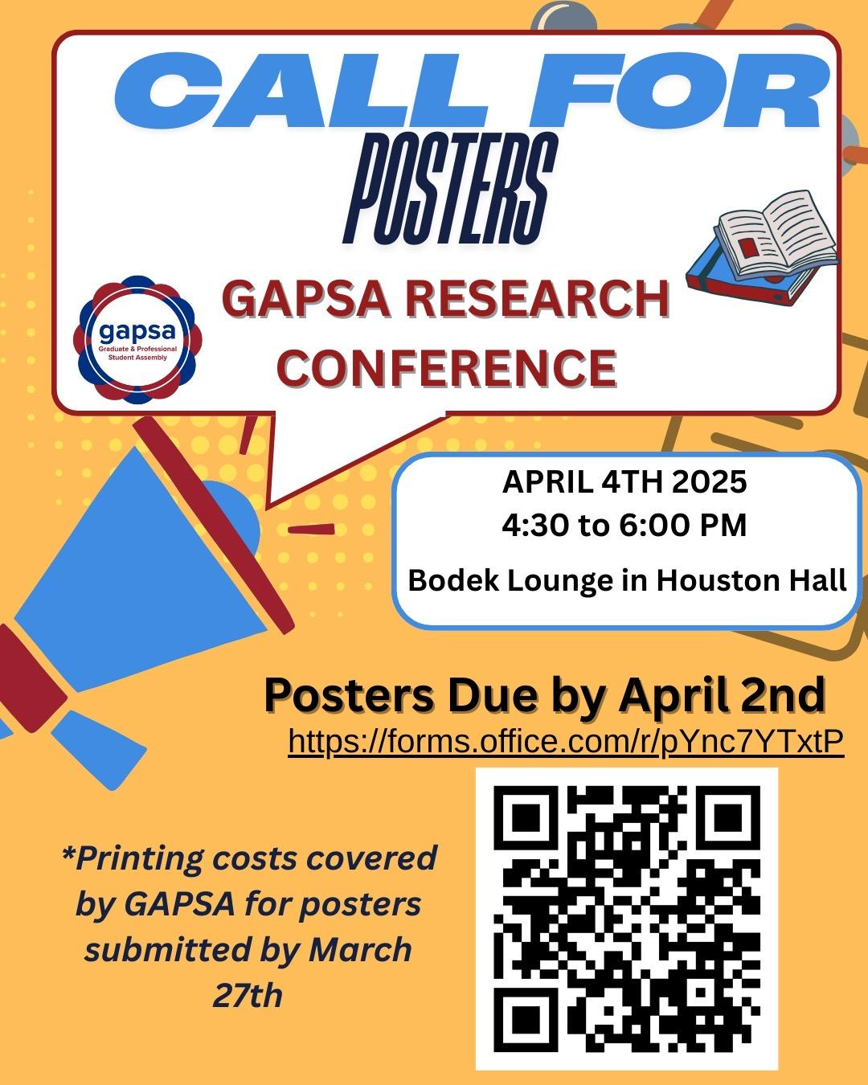
GAPSA Rep updates?
Share with your departments

Slide 13
GAPSA Rep updates?
EVP → Adam; VP of Finance → Carol; President → Ludwig
First year classes are gone for MSE and CBE; a lot of the regular classes are gone on the registration
Rheology - Sueanne Bidstrup Allen
Environmental engineering
Nanoscale Transport -
Polymer physics classes - Daeyon Lee
Mostly classes in BGS/MED
BBCB; CAMB; unless it’s cross listed
Ryan has a memo

Slide 14
Last Chance at Roll Call: Non-voting, voting, and GAPSA reps sign in here!

Slide 15
Any further questions?
Instagram account: @gseg_upenn
Email: gseg@seas.upenn.edu

Slide 16
Links & Logistics
Advertise in the GSEG Newsletter
Submit an event idea
Website
Doc

